Slide 1

Presented by : Fern Bradder , Petra Moyle and Sri Vegunta

Slide 2

WA Crime Insights COVID -19 LOCKDOWN
WA Crime Rates have declined by 23%
WA Domestic Violence reported cases declined by 4%
There is a positive and statistically significant correlation (r = 0.43, p = 0.0) between domestic violence cases and Google searches for 1800 Respect in Australia which can be a suitable variable for predictive policing in the future
Start of Lockdown : March 2020
End of Lockdown : May 2020

Slide 3
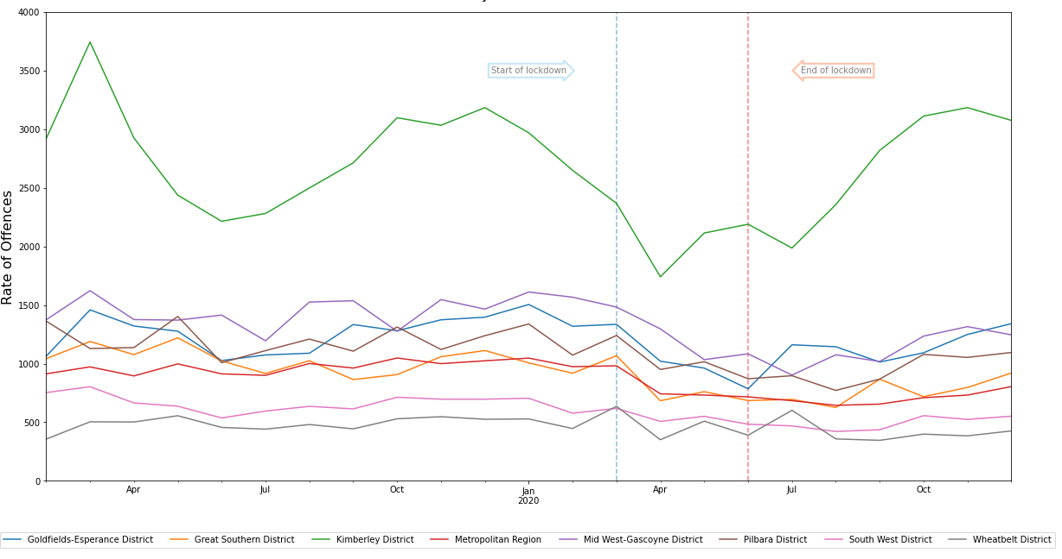
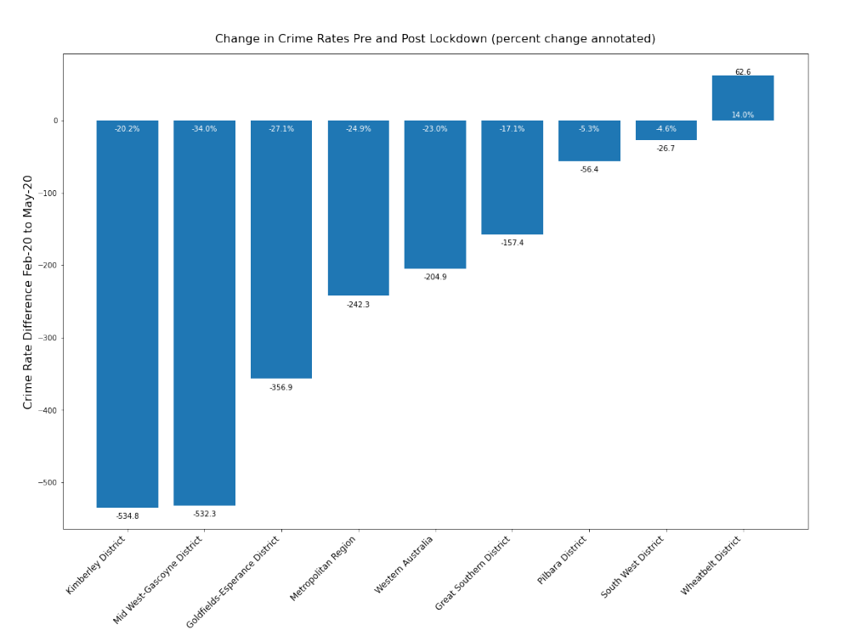
Impact of Covid-19 lockdown on WA Crime Rates by Region
WA Crime Rate
Highest Decrease in Crime Rate
Mid West-Gascoyne District
Unique Increase in Crime Rate
Wheatbelt District
23 %
34 %
14%
Start of Lockdown : March 2020
End of Lockdown : May 2020

Slide 4
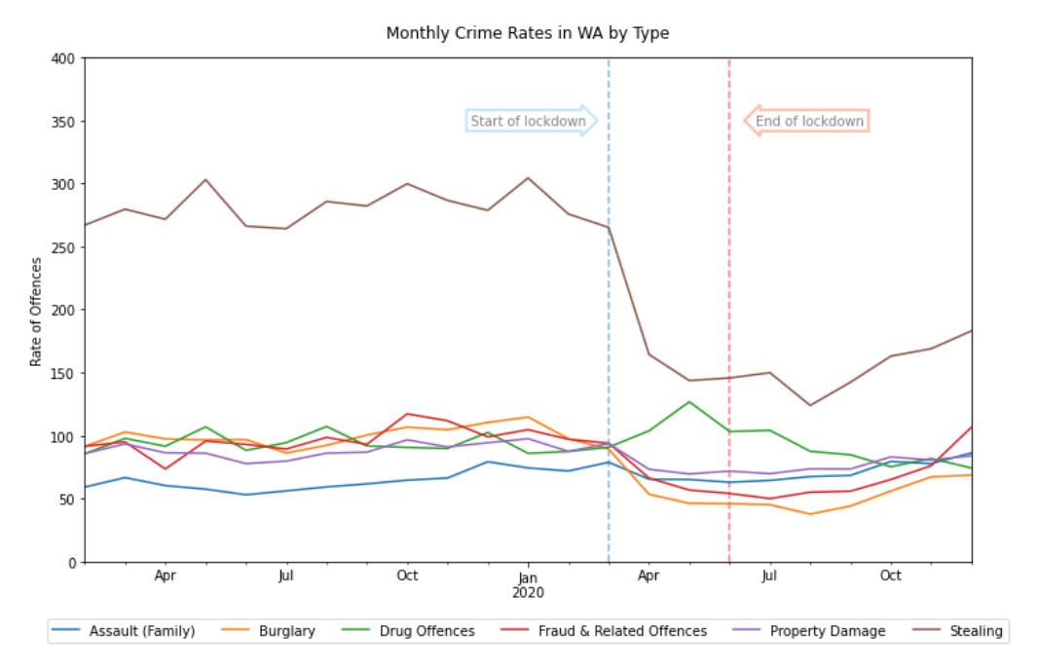
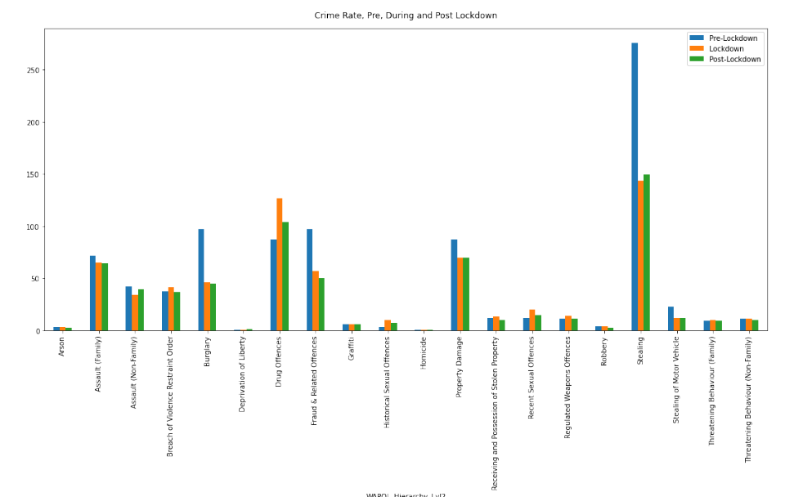
Impact of Covid-19 lockdown on WA Crime Rates by Offence
Top Movements in Crime Rates
Stealing
Burglary
Fraud & Related Offences
Drug Offences
Start of Lockdown : March 2020
End of Lockdown : May 2020

Slide 5

Surge in Domestic Violence across the world during Covid – 19 ?
Selection of Headlines in Guardian on DV and Lockdown
The worst year': domestic violence soars in Australia during Covid-19
Tuesday briefing: Domestic abuse reports surge amid lockdown
Shock new figures fuel fears of more lockdown domestic abuse killings in UK
Calls to domestic abuse helpline in England up by 60% over past year
Fears grow for those facing domestic abuse as England enters second lockdown
Women killed in Spain as coronavirus lockdown sees rise in domestic violence

Slide 6
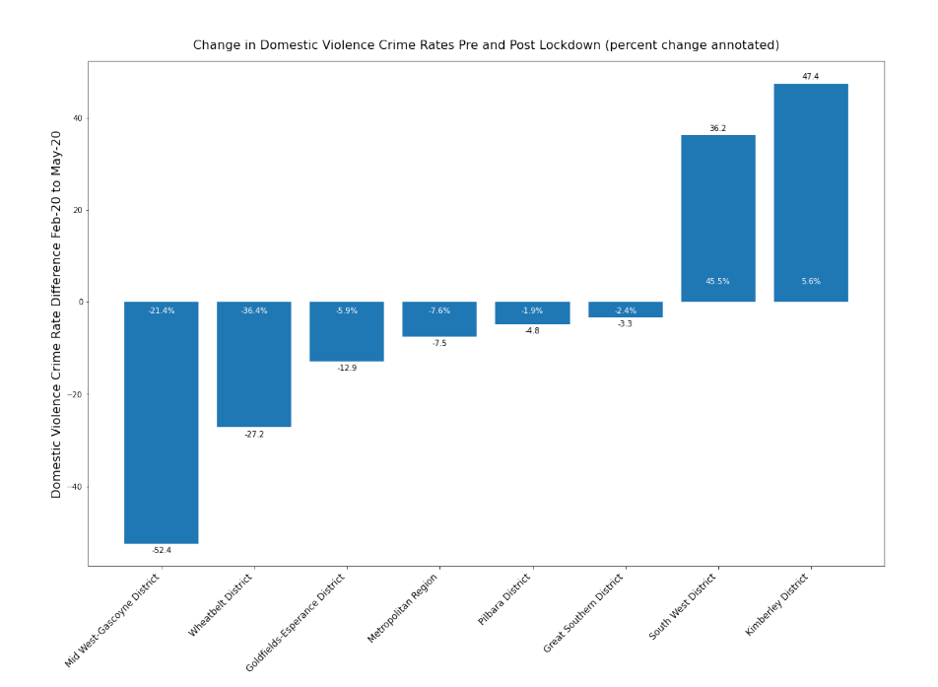
WA Domestic Violence by Region
Highest Decrease in Domestic Violence
Mid West – Gascoyne District
Highest Increase in Domestic Violence
Kimberly District
21 %
6 %
Start of Lockdown : March 2020
End of Lockdown : May 2020

Slide 7
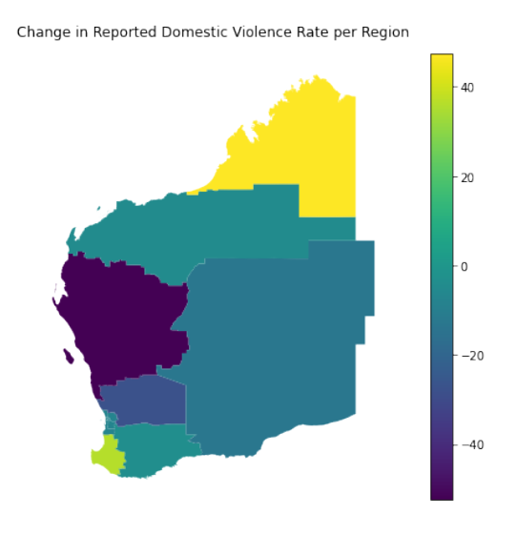
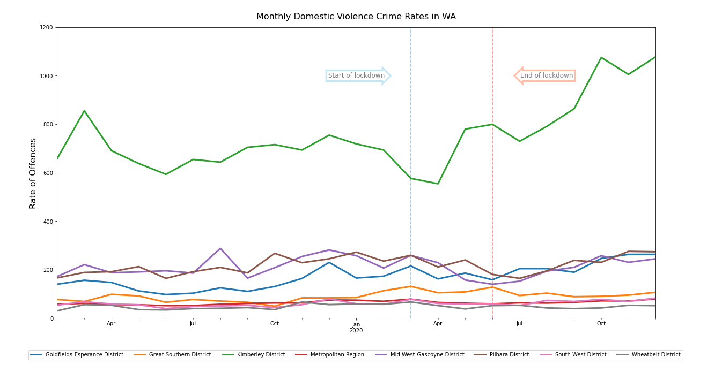
WA Domestic Violence Trends by Region

Slide 8
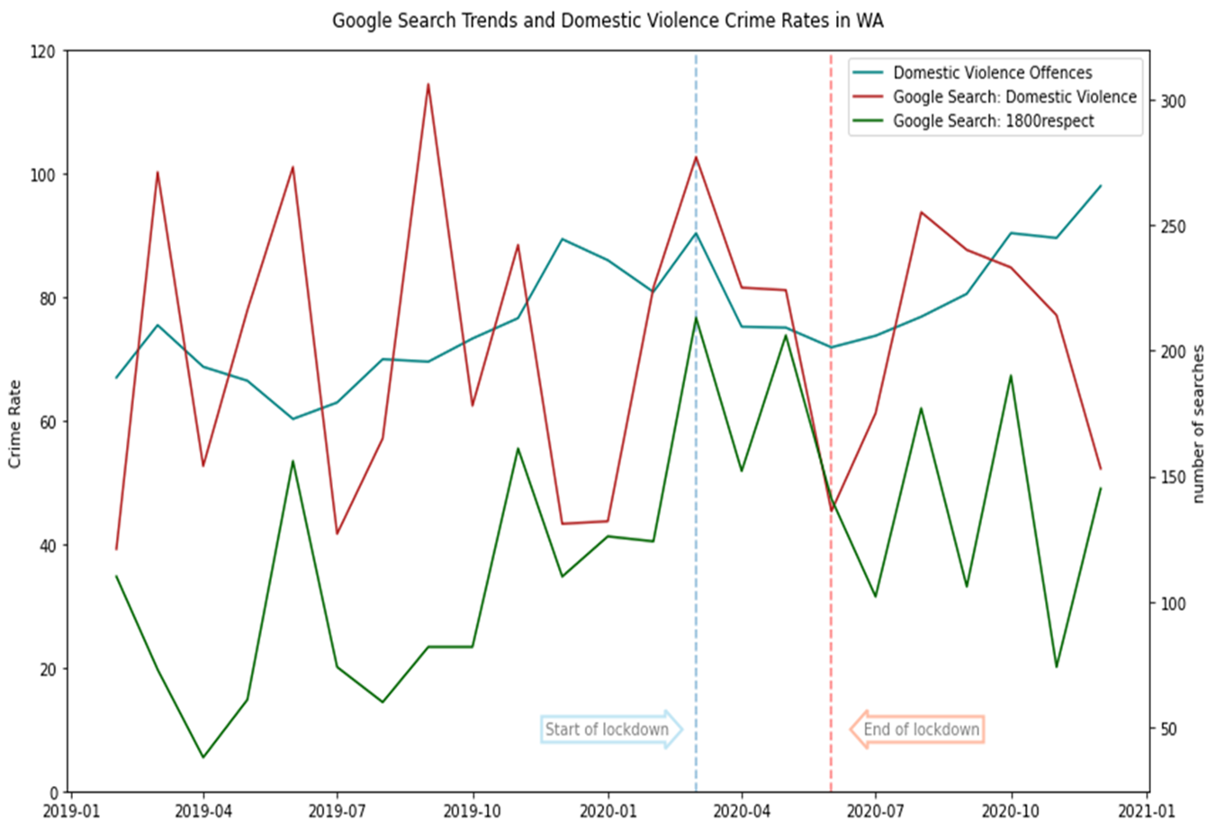
Are there other indicators of domestic violence?

Slide 9
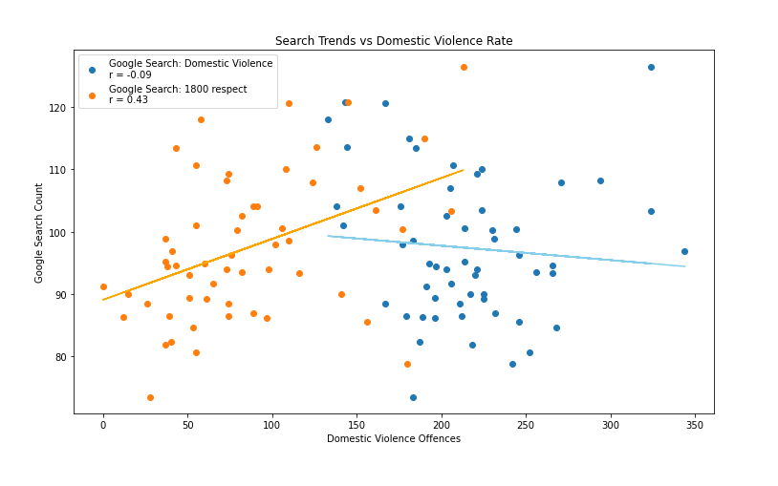
Can we predict DV by predictive policing ?
Trends are for Australia as a whole

Slide 10



Slide 11
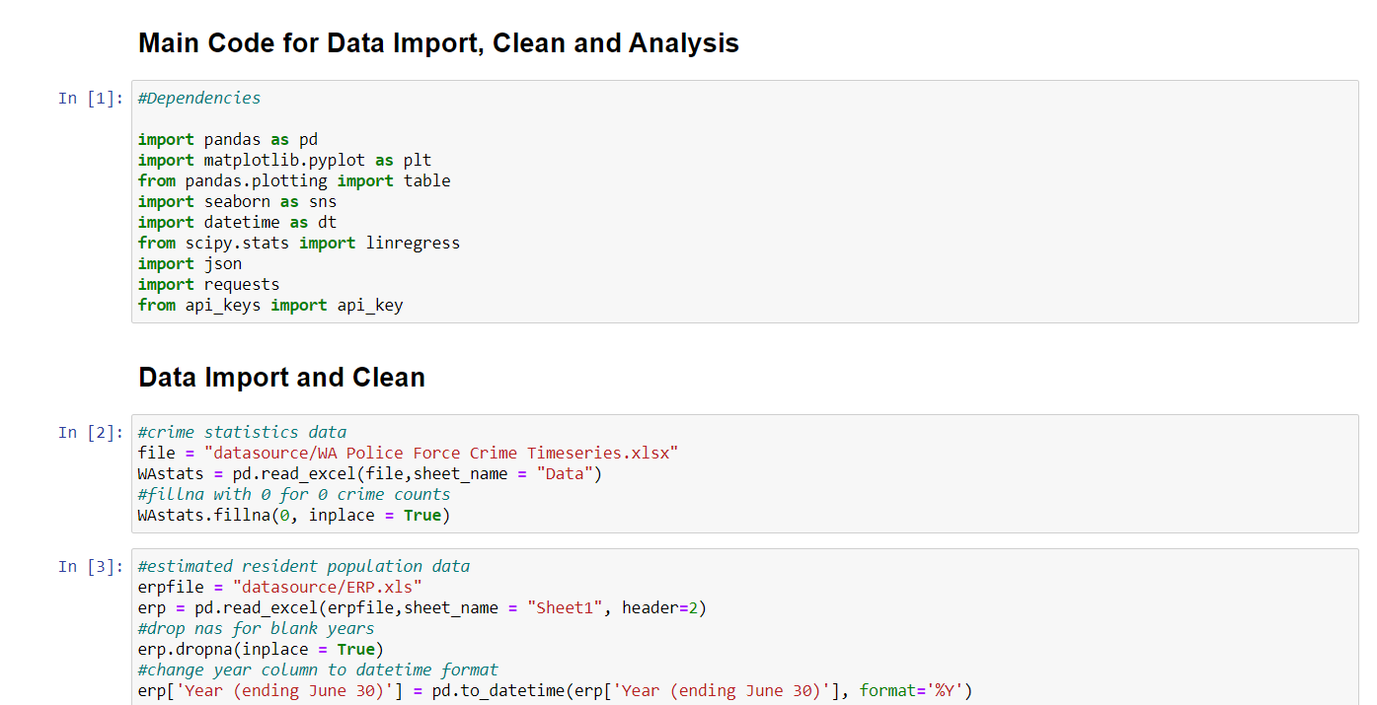

Slide 12
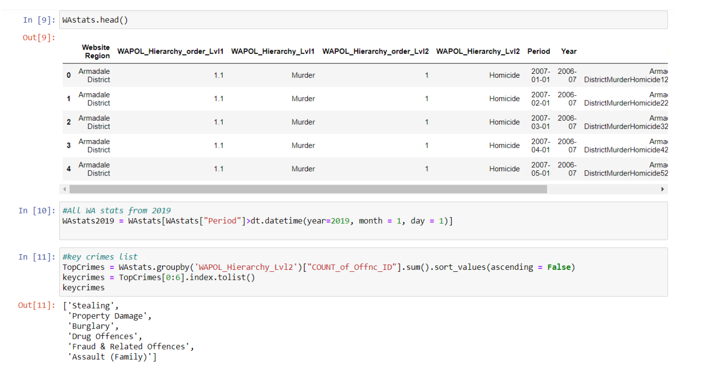

Slide 13
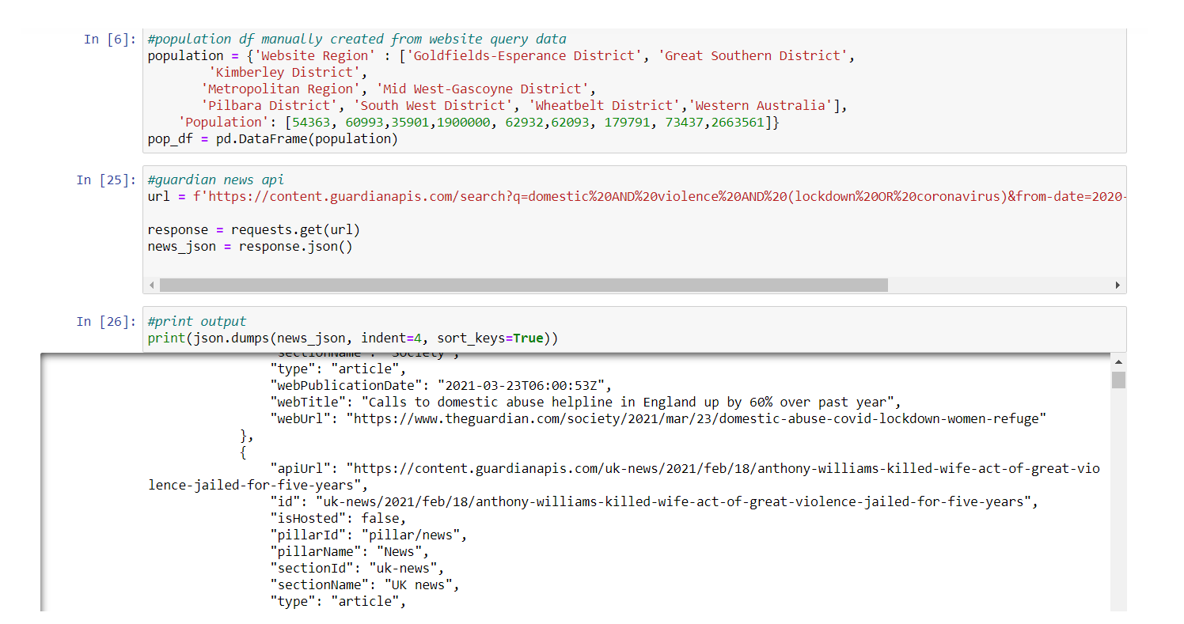

Slide 14
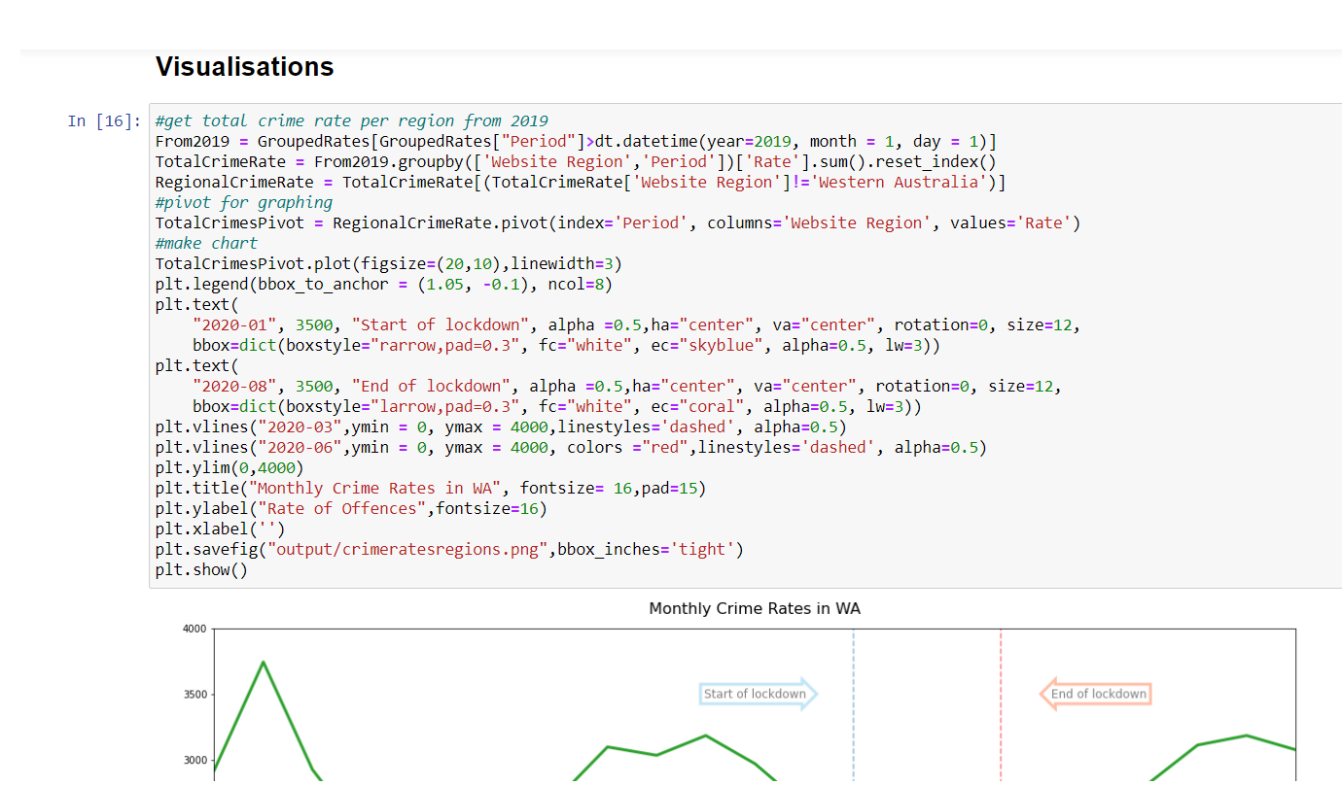

Slide 15
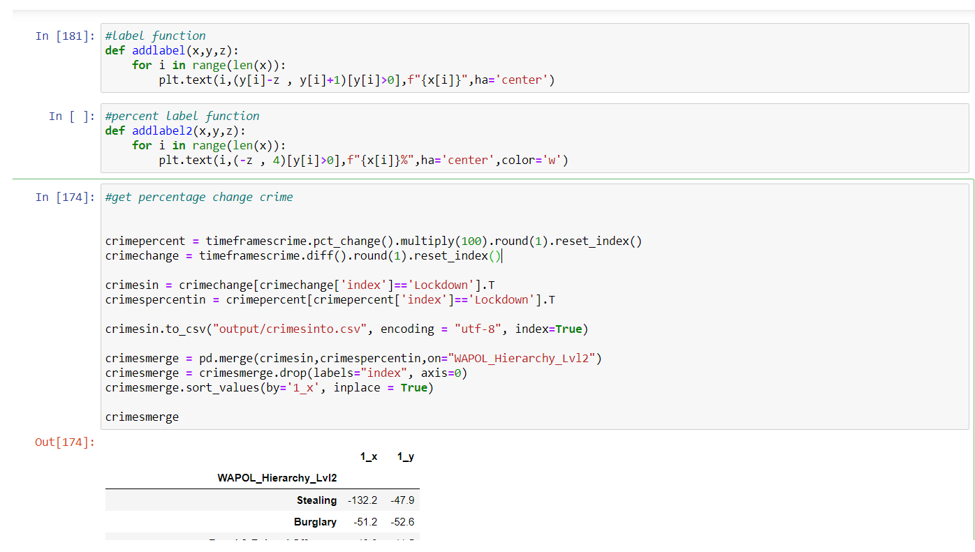

Slide 16
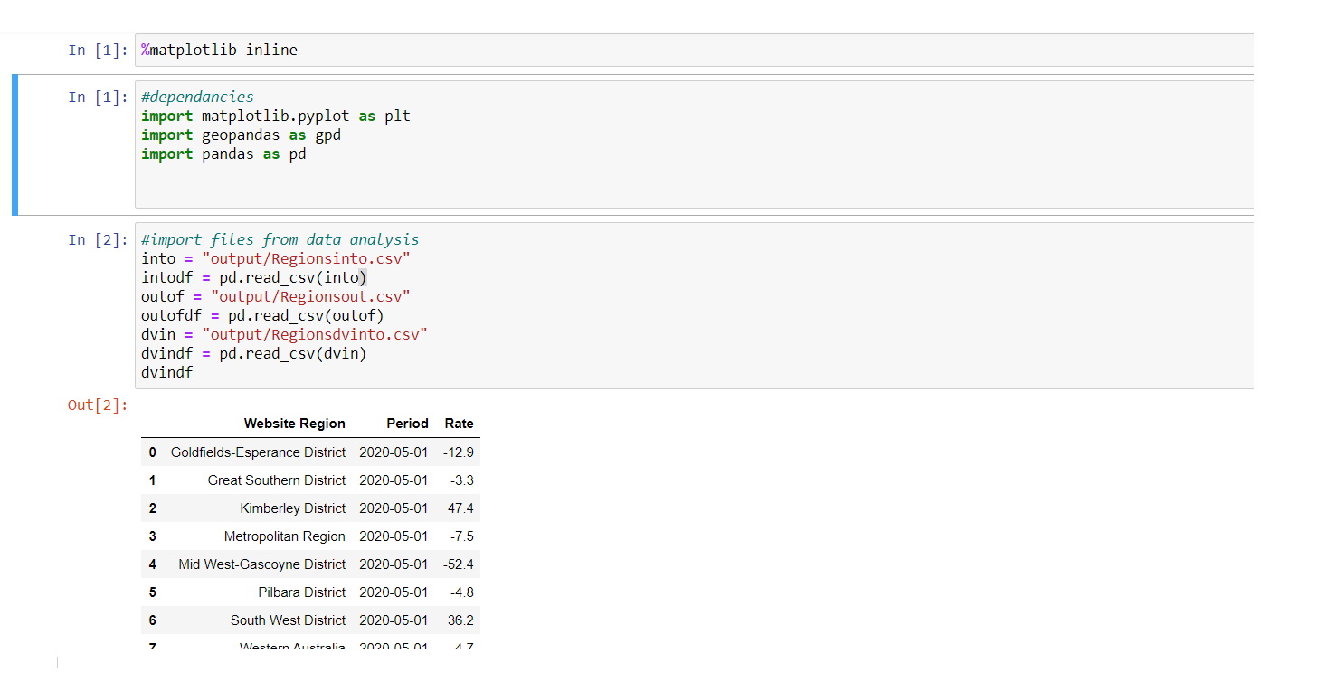

Slide 17
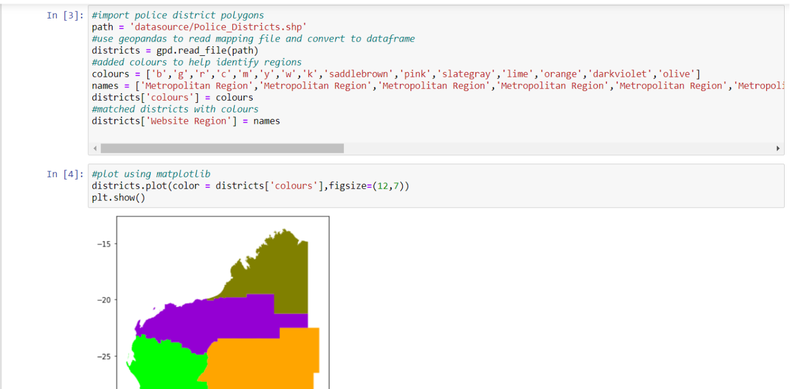

Slide 18
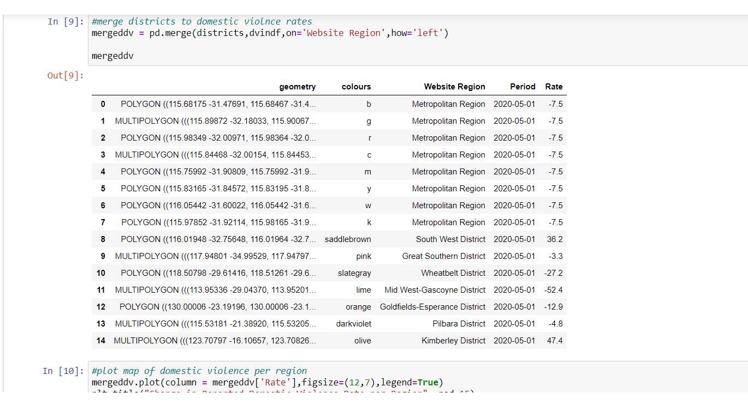

Slide 19
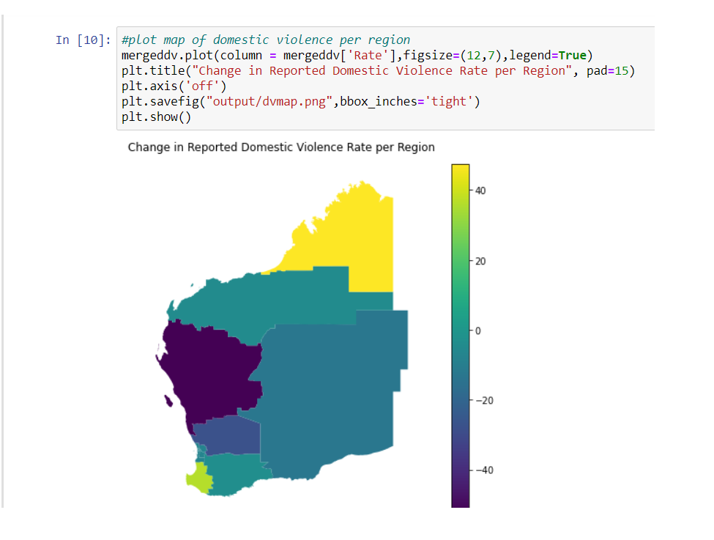

Slide 20
Sources
WA crime statistics
https://www.police.wa.gov.au/Crime/CrimeStatistics#/
WA Parliamentary Library
https://profile.id.com.au/wapl/population-estimate?BMID=40
WAPOL District Boundaries
https://catalogue.data.wa.gov.au/dataset/wa-police-district-boundaries
The Guardian API
https://open-platform.theguardian.com/
Google Trends
https://trends.google.com/trends/?geo=AU

